Slide 1

REMAINING USEFUL LIFE PREDICTION AND LIFECYCLE OPTIMIZATION OF LITHIUM ION BATTERIES
NATIONAL INSTITUTE OF TECHNOLOGY RAIPUR
DEPARTMENT OF ELECTRICAL ENGINEERING
7TH SEMESTER PROJECT PRESENTATION
ON
ADITYA RAY 20117006 | PANKAJ AGRAWAL 20117068 | PRAGYA CHURENDRA 20117071
GUIDED BY
DR. LALIT KUMAR SAHU (ASSISTANT PROFESSOR)

Slide 2
WHAT?
An device which can be integrated in BMS of electric vehicles which will provide following features -
Will predict when the battery is going to die.
Will Find the optimum running cycle for maximum battery life.
Will provide all operating characteristics such as voltage, current, SOC etc on an frontend web application.
Help in further research and analysis.

Slide 3
WHY?
Existing Batteries are not optimizing their full capacity due to improper usage and lack of data among manufacturers and of awareness among end users.
For example-
Charging the battery to full level slowly decreases its maximum life.
Fast charging is not an good option always.
When an EV is going at cruise it's range can be dramatically increased .
When an battery should be replaced is not a very indicative thing.
.

Slide 4
PROJECT FLOW
DATA GENERATION AND PREPARATION
DATA TRANSPORTATION
MACHINE LEARNING

Slide 5
METHODOLOGY

Slide 6
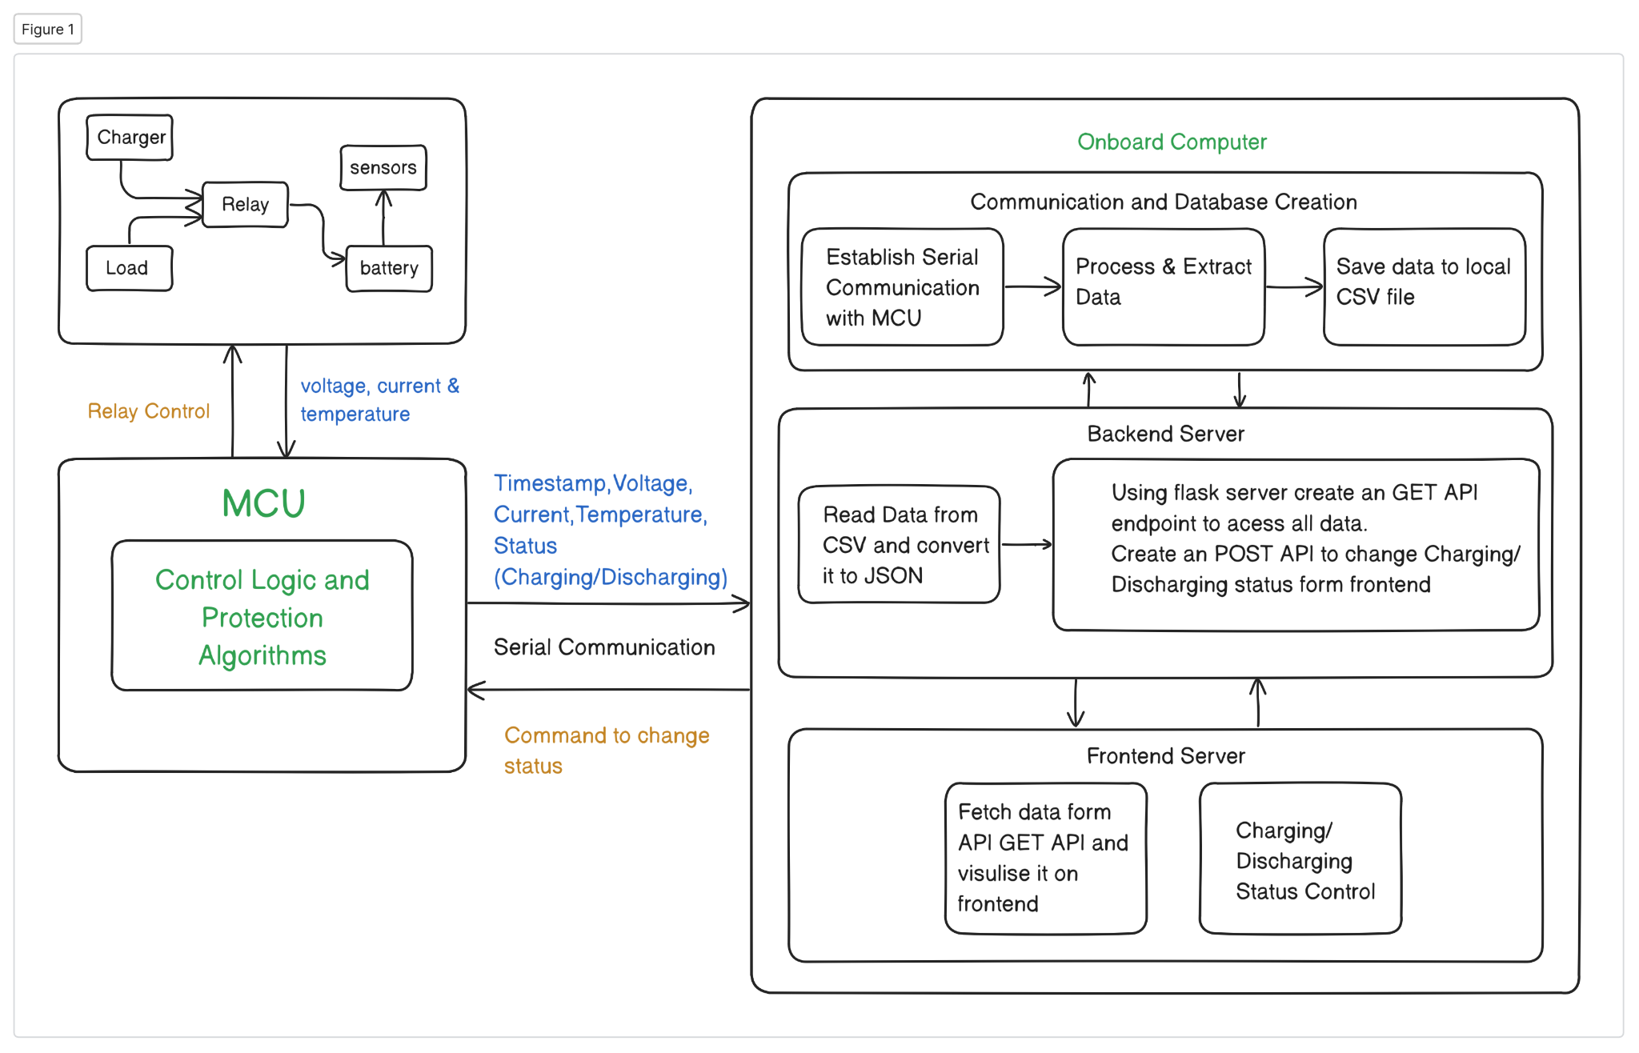

Slide 7
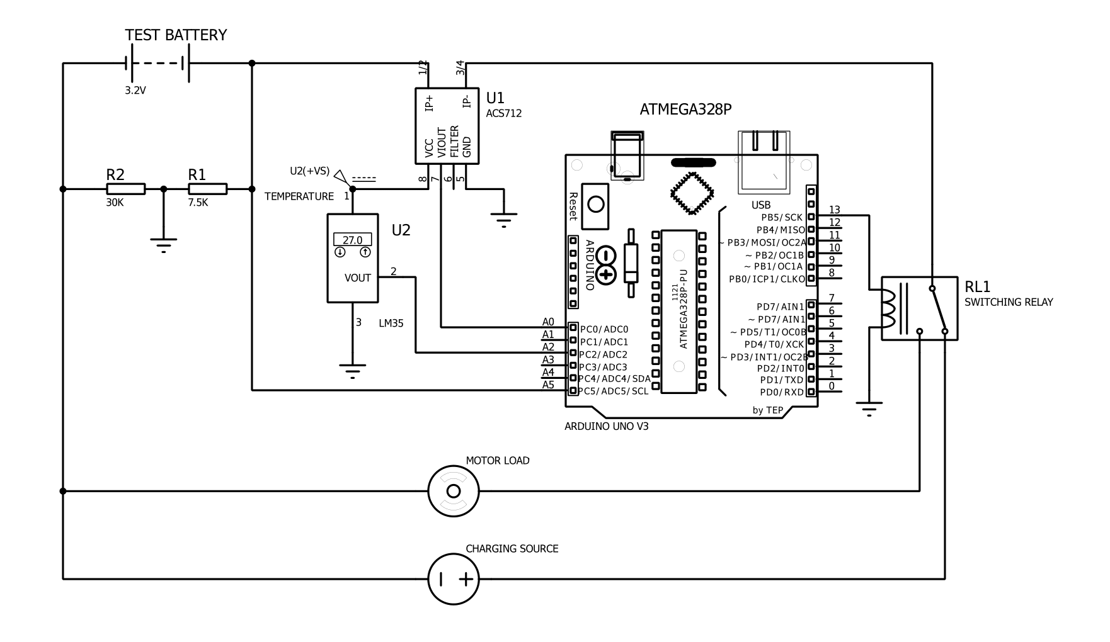
CIRCUIT ARRANGEMENT

Slide 8
THE FIRMWARE
Over Charge protection of the battery.
Automated Cutoff of charging if battery is critically low.
Over Current protection of the hardware.
Receiving Commands from frontend application to change its charging/ discharging state.
Extraction and calculation of sensor data for onboard analog to digital converter.
Encapsulation of all data in a format which can be forwarded for further processing.
Establishing a serial communication with raspberry pi.

Slide 9
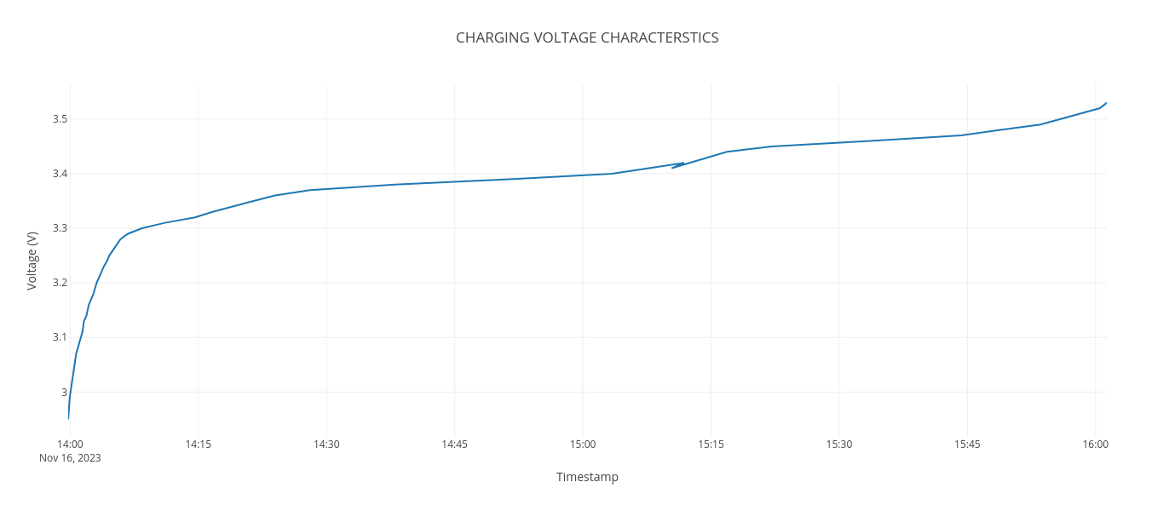
CHARGING VOLTAGE CHARACTERISTICS

Slide 10
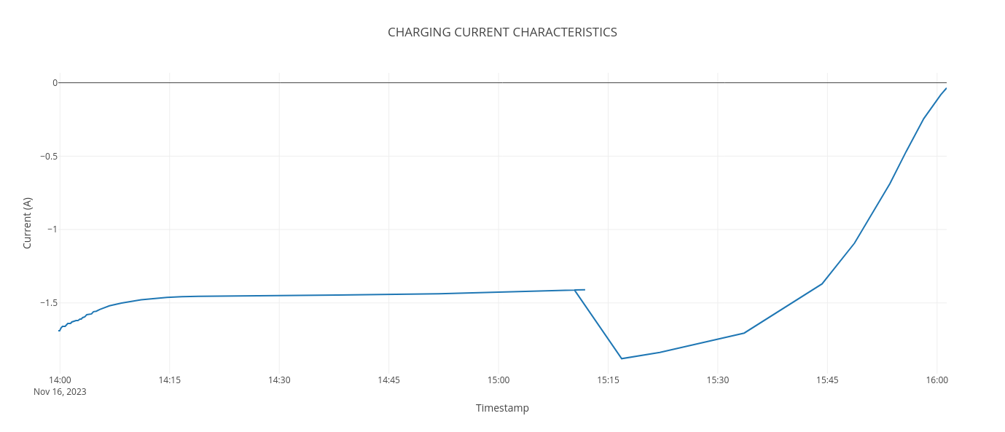
CHARGING CURRENT CHARACTERISTICS

Slide 11
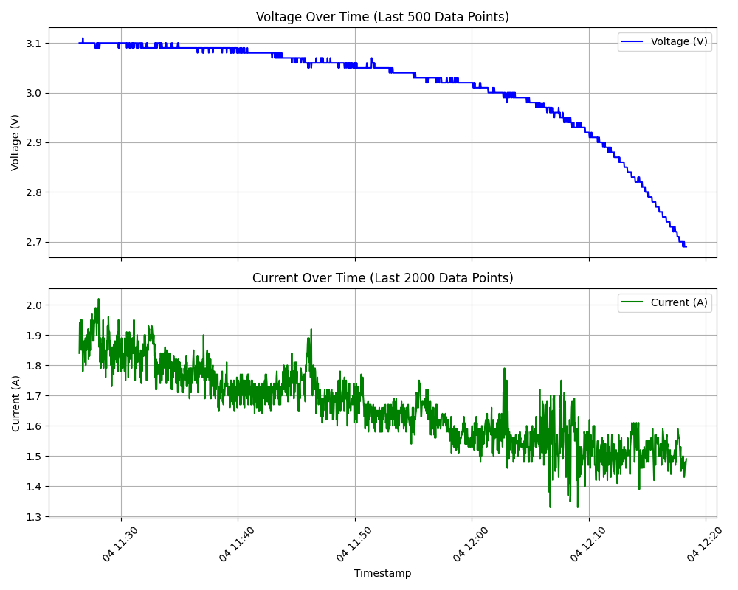
DISCHARGING VOLTAGE AND CURRENT CHARACTERISTICS

Slide 12
STATE OF CHARGE
The state of charge (SoC) of cells is defined as the available capacity in ampere-hours (Ah) expressed as a percentage of its rated capacity.
Additionally, evaluating the state of health (SOH) of a battery becomes significant, representing the battery's capacity to store and deliver electrical energy in comparison to a new battery.

Slide 13
METHODS FOR SOC ESTIMATION
VOLTAGE CURRENT METHOD
COULOMB COUNTING METHOD
KALMAN FILTERING METHOD
MACHINE LEARNING

Slide 14
COULOMB COUNTING METHOD
The Coulomb counting method is based on the principle that the total charge that flows into or out of a battery is equal to the integral of the current with respect to time. In simple terms, it involves measuring the current flowing into or out of a battery over time and integrating these values to estimate the total charge passed through the battery.
SOC (𝑡) = SOC (𝑡 − 1) +𝐼 (𝑡)𝑛Δt

Slide 15
ALGORITHM
Store instantaneous current value.
Calculate the time interval between two consecutive values (it should be smaller than 10s).
Calculate the area swept by the current curve during this duration.
Add this to an memory variable. This will be our incoming/outgoing charge.

Slide 16
REAL TIME DATA DISPLAY
DATA PREPROCESSING
DATA STORAGE
SYSTEM DESIGN

Slide 17
DATA STORAGE
A complete data analysis platform should set up a corresponding database, which is conducive to the realization of data centralized management and interface sharing, data security, repair faults, and system development easily .
The MySQL with open-sources and high-performance that can provide safe and reliable data storage support for a web platform, as well as improving data independence, is employed in this work.

Slide 18
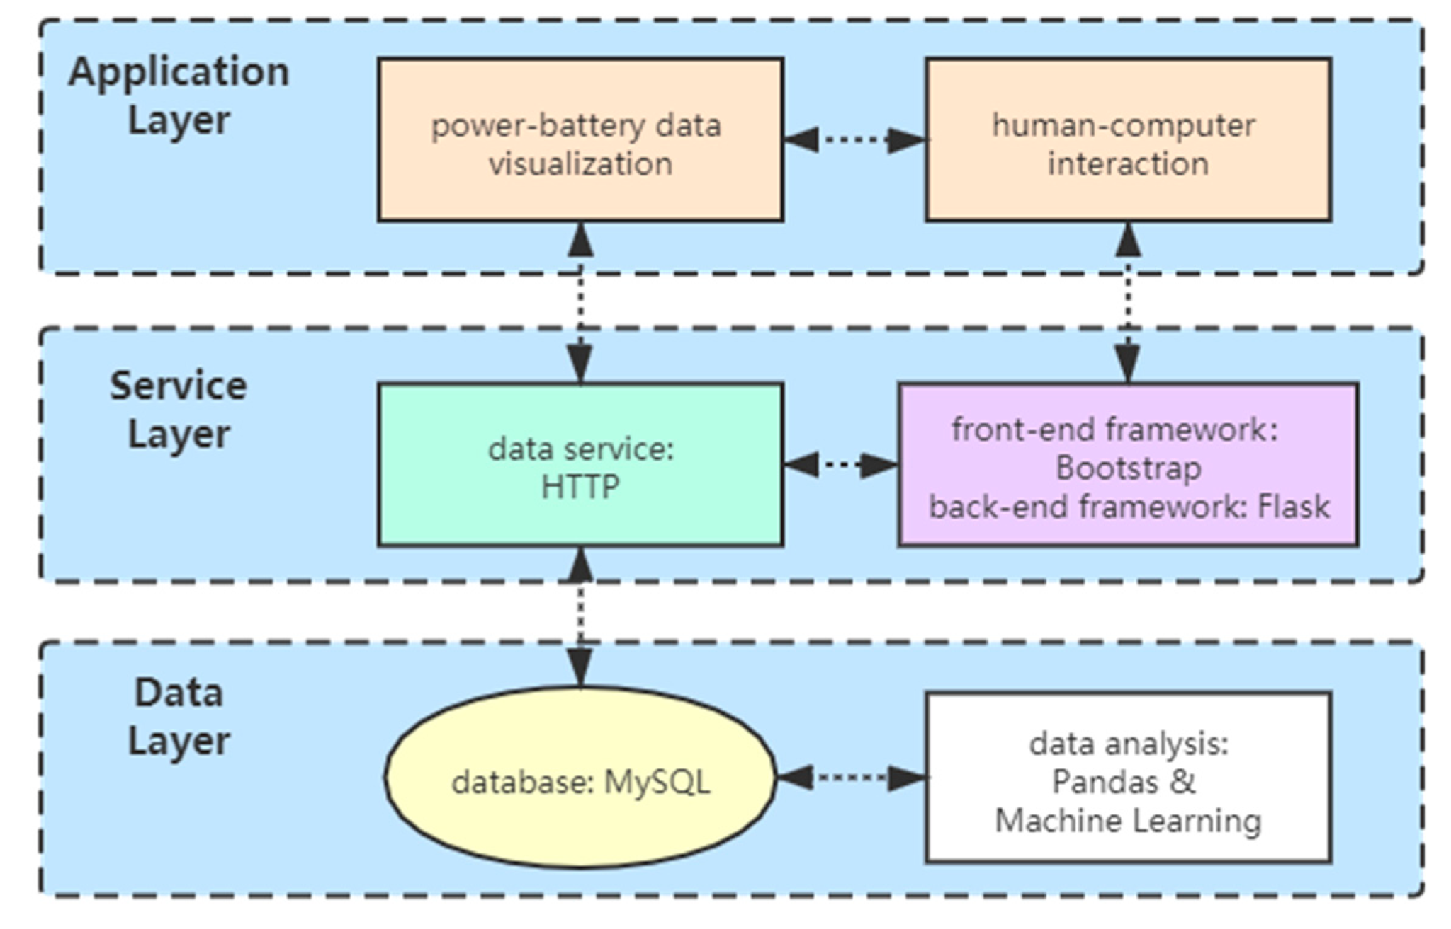
SYSTEM DESIGN

Slide 19
REAL TIME DATA DISPLAY
Battery Performance Monitoring
SOH, SOC, SOS
Optimizing Battery Usage
Load management , Energy Efficiency
Predictive Maintenance
Fault Detection,Maintenance Scheduling
Battery Management System
Balancing, Temperature Control, Performance Improvement

Slide 20
Predictive Maintenance
Increased Equipment Lifespan
Why?
Cost Reduction
Enhanced safety
How?
Data Collection
Data Analysis
Predictive Models
Advantages
Improved Safety
Reduced Downtime
Cost Savings

Slide 21
RUL ESTIMATION OF LI-ION BATTERIES
REMAINING USEFUL LIFE (RUL)
Why?
Threats
Proactive Maintenance Planning
Optimizing Asset Management
Cost Savings
Data Collection
Model Development
Monitoring And Prediction
Decision Support
Factors Influencing
Advantages
Cycling Aging
Operating Conditions
Capacity Fading
Optimized Maintenance Strategies
Improved Reliability
Environmental Impact

Slide 22
LIFE CYCLE OPTIMIZATION OF LI-ION BATTERIES
Material Selection
Manufacturing Process
Raw Materials
Recyclability
Energy Efficiency
Reduced Waste
End-of-Life Considerations
Environmental-Impact Assessment
Recycling Programs
Second-Life Applications
Life Cycle Assessment (LCA)
Carbon Footprint Reduction

Slide 23
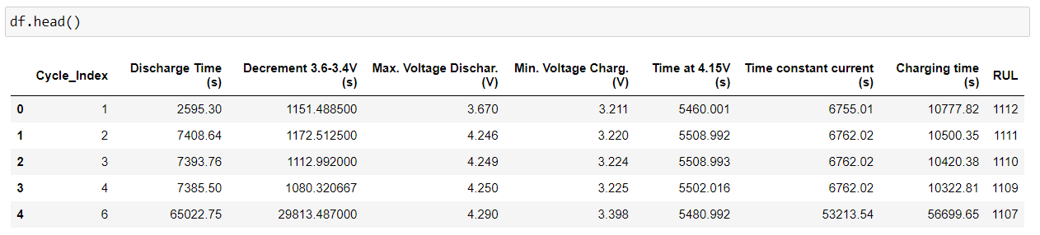
DATASET OVERVIEW
The Hawaii Natural Energy Institute examined 14 batteries at specified weather conditions. From that source dataset, we created features that showcase the voltage and current behavior over each cycle. Those features can be used to predict the remaining useful life (RUL) of the batteries. The dataset contains the summary of the 14 batteries.

Slide 24
MODELS USED FOR RUL PREDICTION
EXTRA TREES REGRESSOR
RANDOM FOREST REGRESSION
EXTREME GRADIENT BOOSTING
SUPPORT VECTOR REGRESSOR

Slide 25
MODELS USED FOR RUL PREDICTION
LINEAR REGRESSION
LASSO REGRESSION
RIDGE REGRESSION
ELASTIC NET

Slide 26
CONCLUSION
The comparative study of machine learning models suggested that XGBoost model is excellent for RUL estimation.
Quality dataset for research and analysis was generated.
New ways to optimize the battery cycle were implemented

Slide 27
FUTURE SCOPES
The device can be printed on small pcb with a more specialized and compact microprocessor and microcontrollers.
The device can be incorporated in BMS of an electric vehicle. It can be an added advantage increasing the range of the EV significantly.
An user recommender system can be expanded upon this project which will enable the users to get insights and commands to guide them towards better usage of their battery.
Smart Grid Integration : By communicating with the grid, the device can participate in demand response programs, helping to manage peak loads and contributing to a more sustainable and resilient energy infrastructure.

